Slide 1
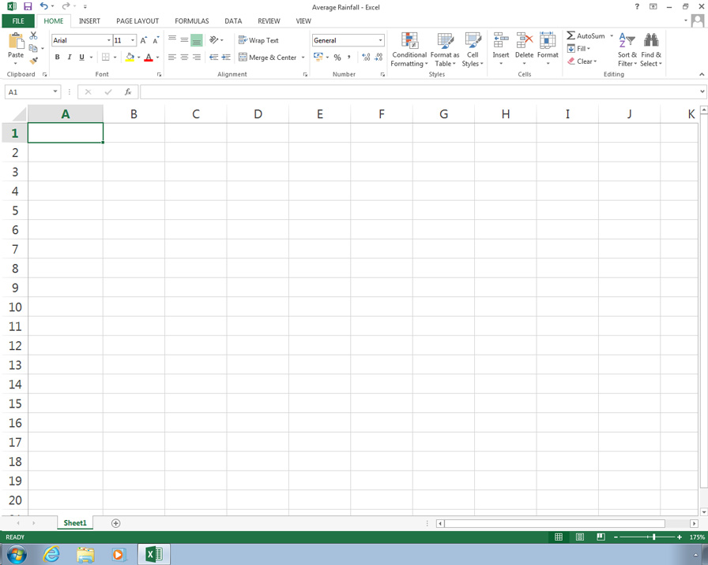
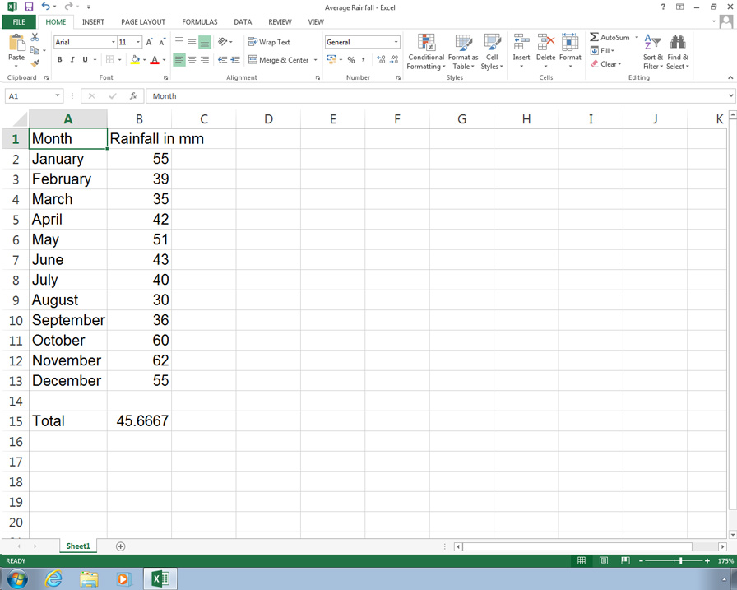
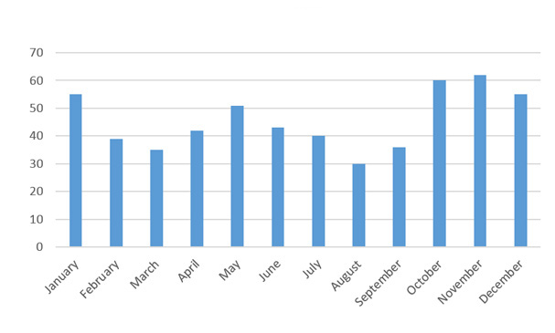
Introduction to Spreadsheets
Average Monthly Rainfall in Cyprus
Rainfall in mm
Month
In this presentation you will:
see how to load a spreadsheet program and open files
Next >

Slide 2
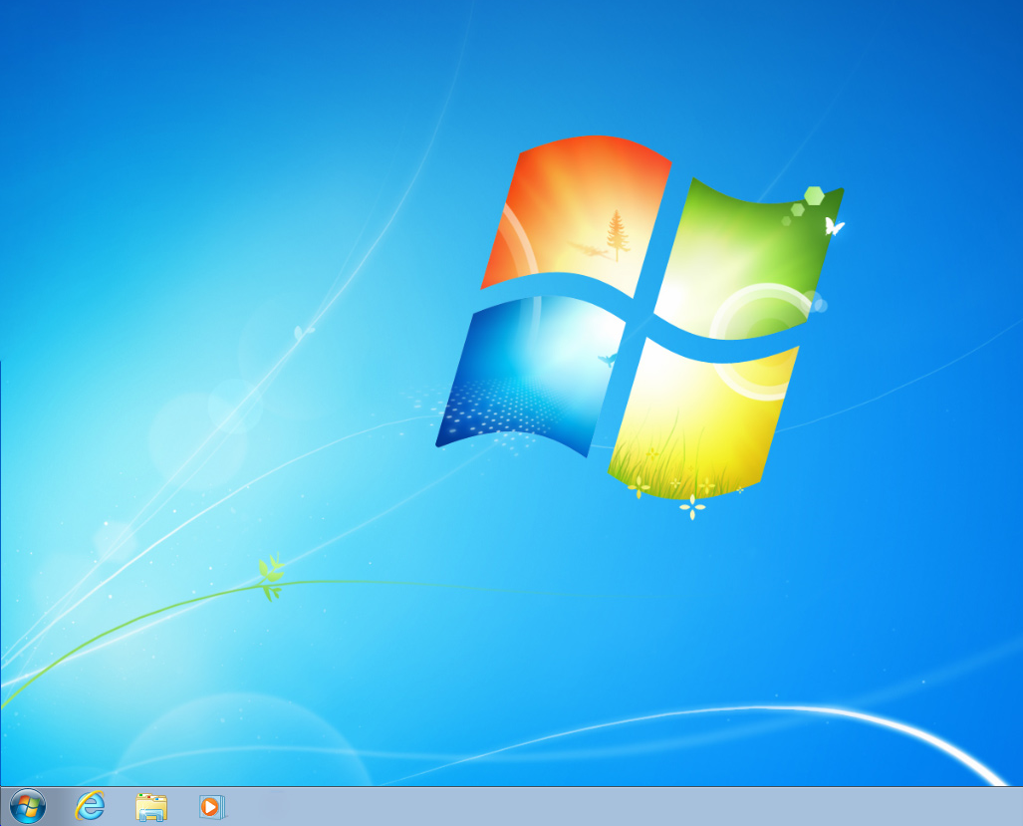
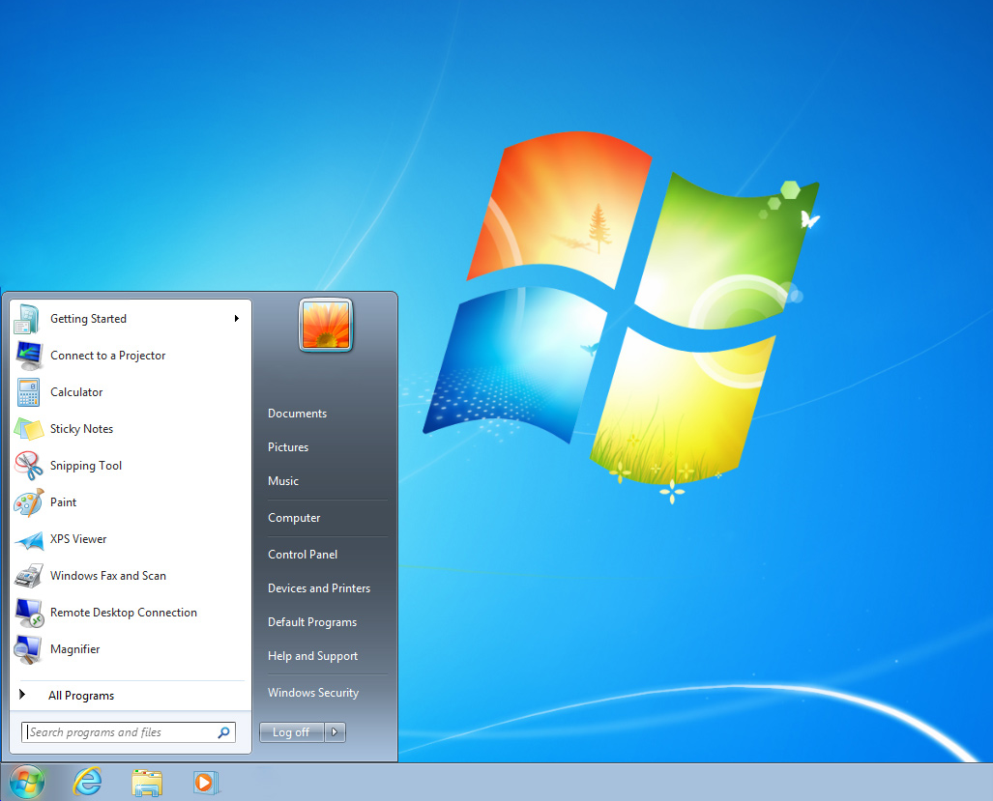
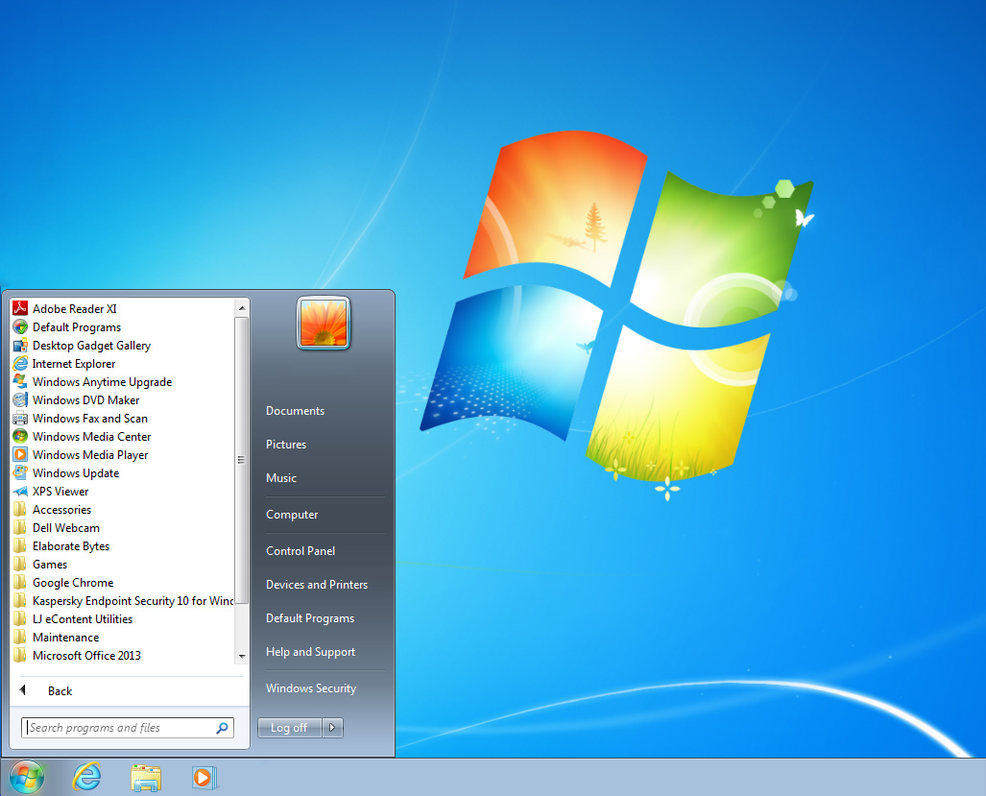


Introduction
A spreadsheet is a software application that runs on a computer.
To run the software, click on the icon on the desktop or on the start menu.
Next >

Slide 3
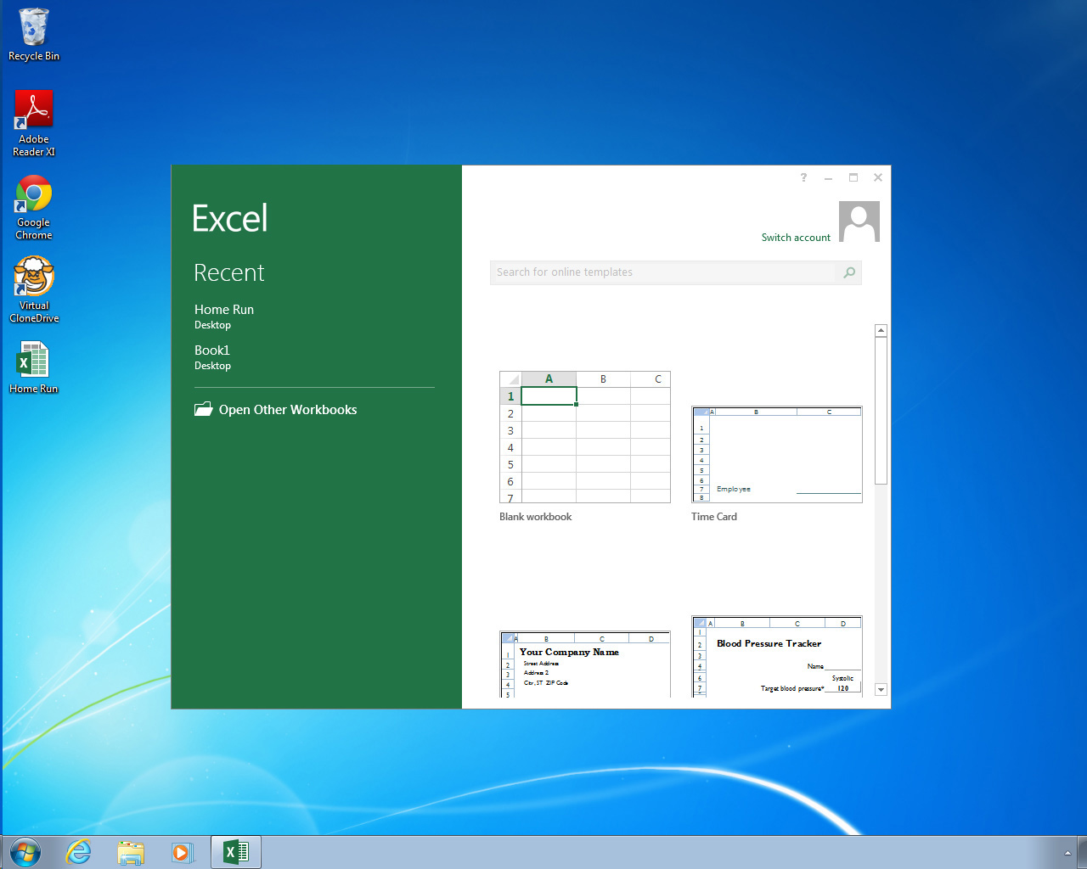

Spreadsheet
t
Cell
The spreadsheet opens with a new empty file.
A spreadsheet consists of a number of small boxes called cells.
Next >

Slide 4
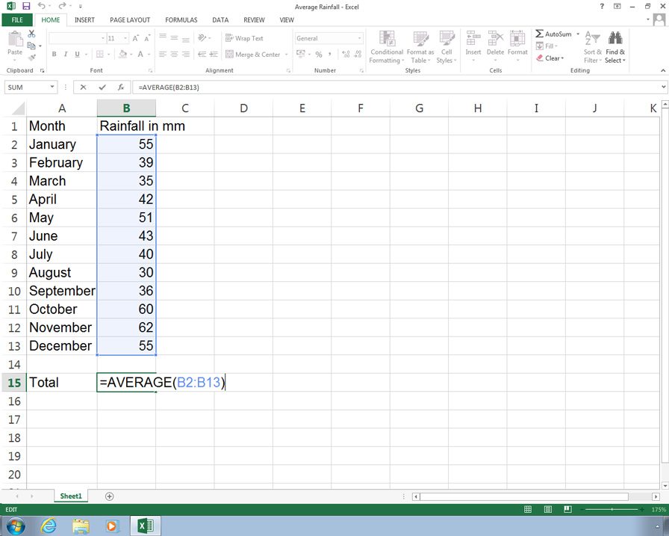
Using a Spreadsheet
A spreadsheet is a tool for working with tables.
Spreadsheets are used for making lists and doing calculations.
Next >

Slide 5
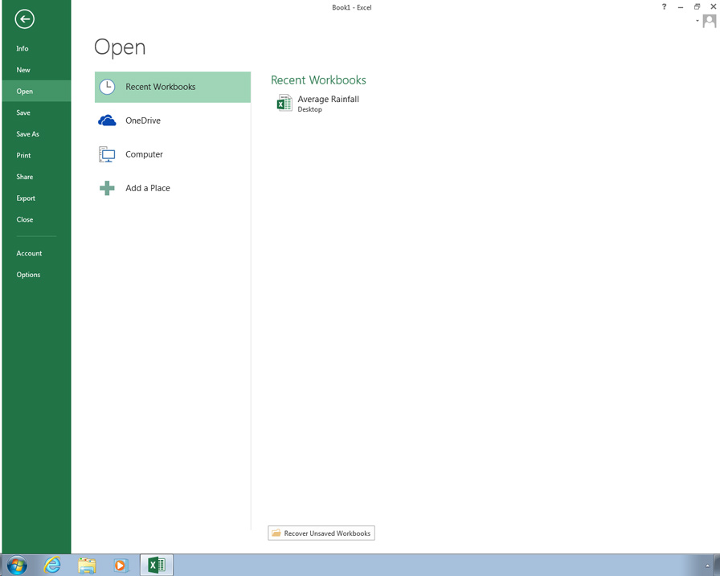
Loading a File
Numbers
Text
To open a spreadsheet file, use the menu.
The cells in this spreadsheet contain text and numbers.
Next >

Slide 6
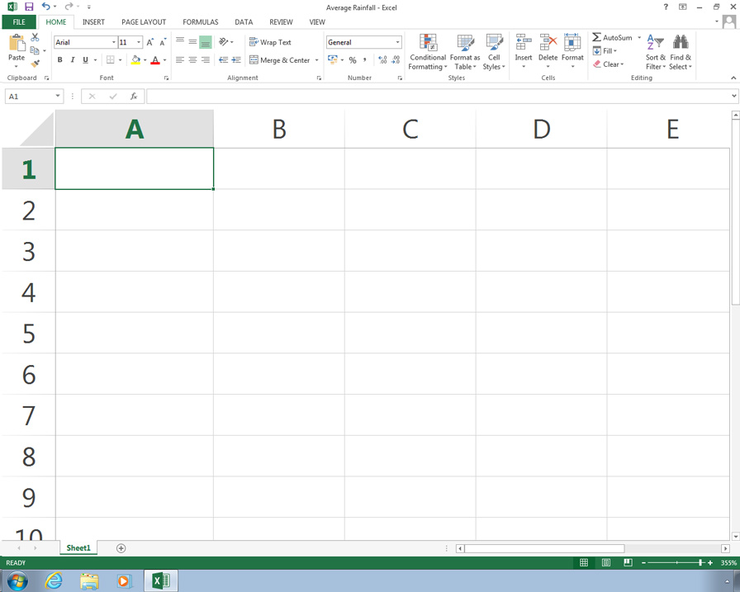
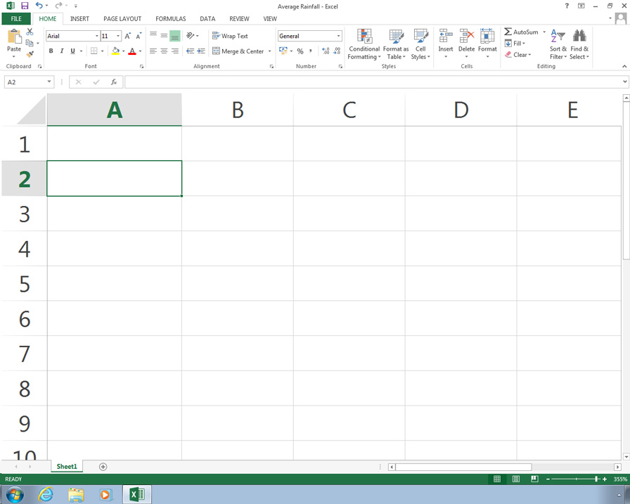
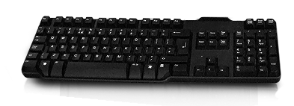

Editing a Spreadsheet
Year
Month
Month
Year
To enter data into a cell, click in the cell and type it in. Then press the enter key.
To change the data in a cell, click in the cell and enter the new data.
Next >

Slide 7
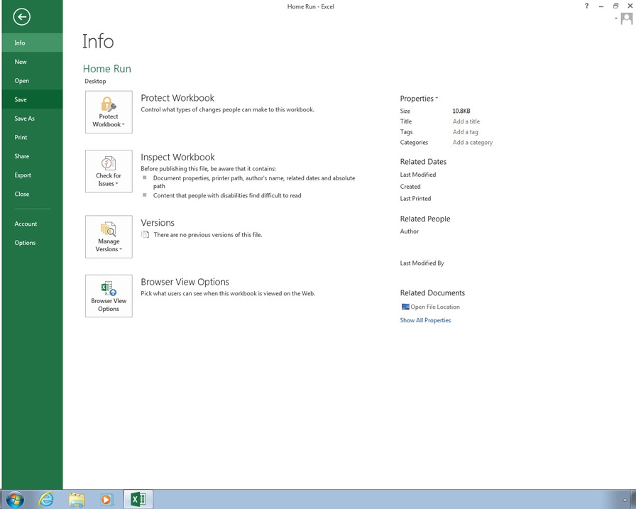
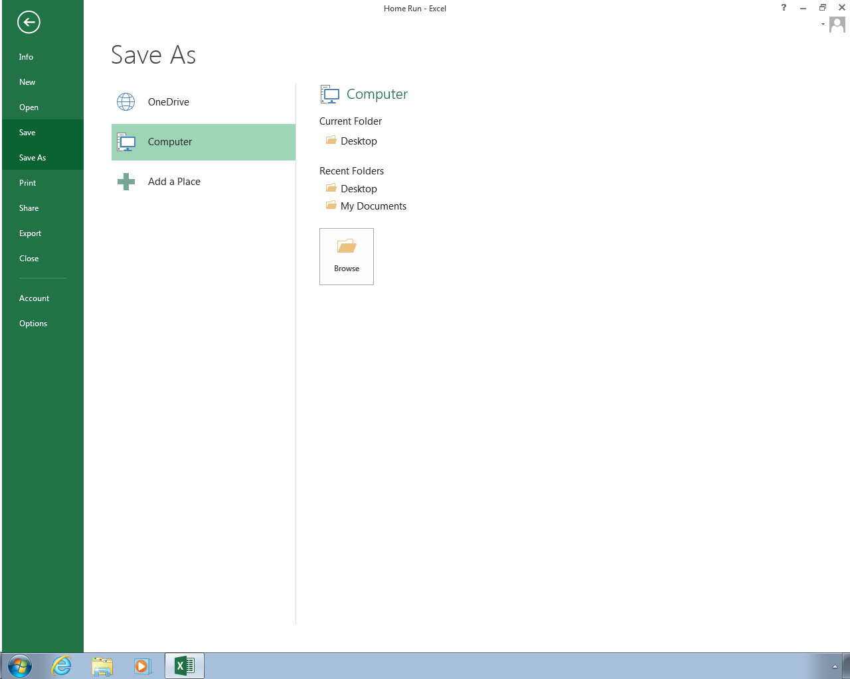
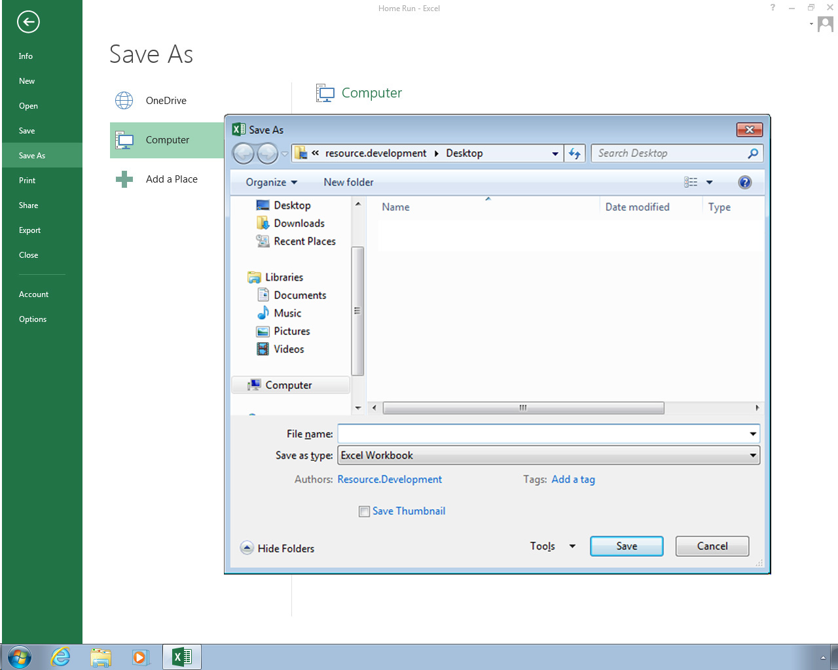
Saving a Spreadsheet
Average Rainfall
To save a spreadsheet file, use the menu.
Give the file a sensible name to help you find the file later.
Next >

Slide 8
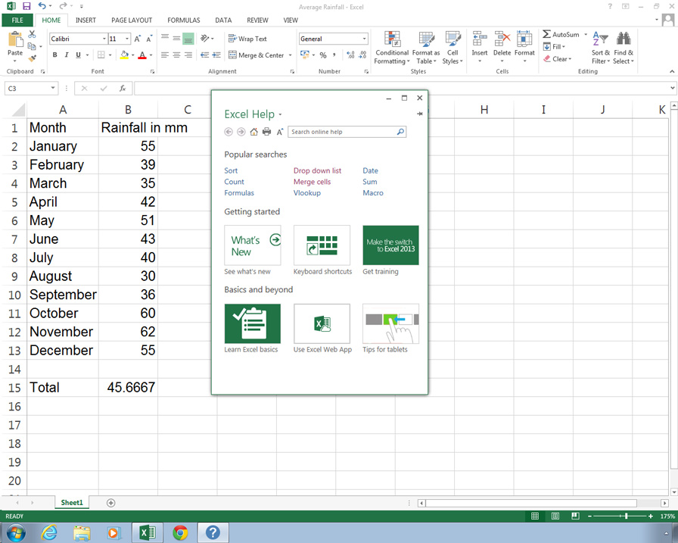
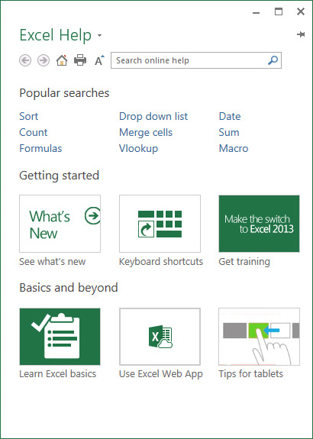
Using Help
Spreadsheet software has Help included.
For Help, press F1 on the keyboard or click on Help on the menu.
Next >

Slide 9
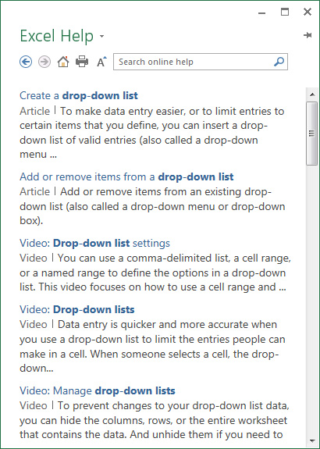

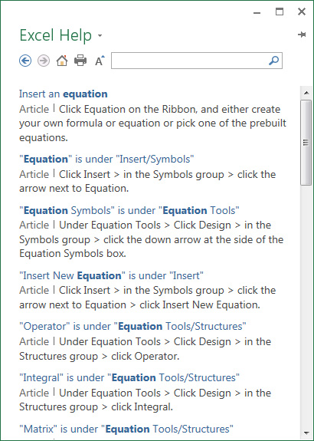
Using Help
Equations
Click on a Help item from a list to find out about it.
Search for Help on a subject by entering text.
Next >

Slide 10
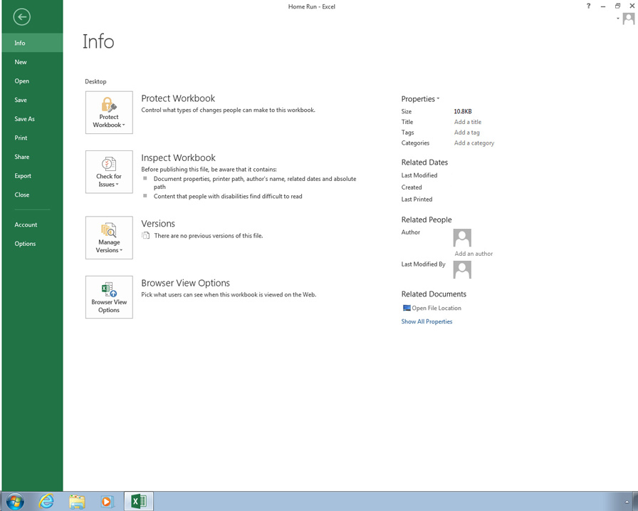
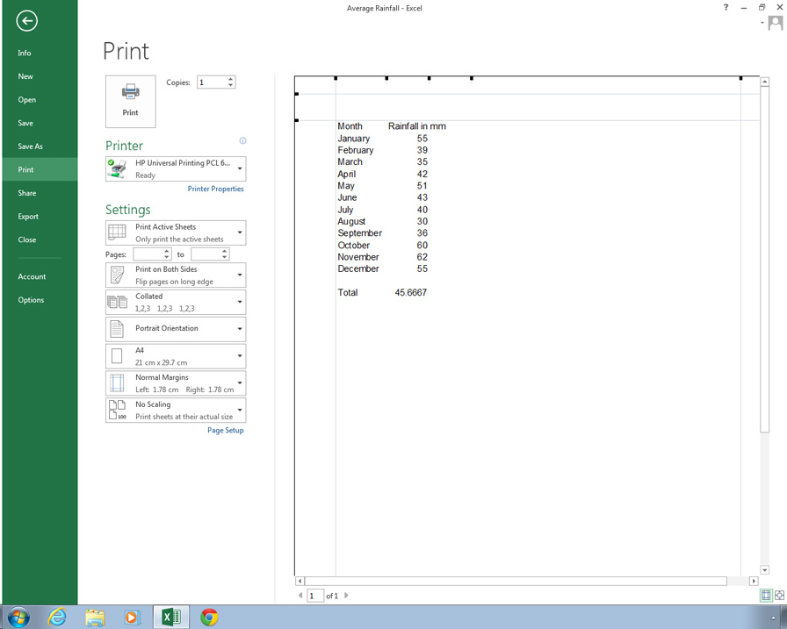
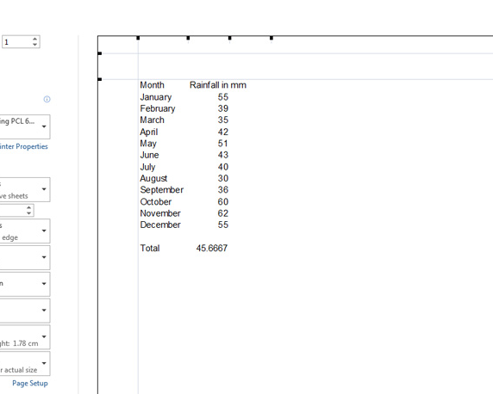
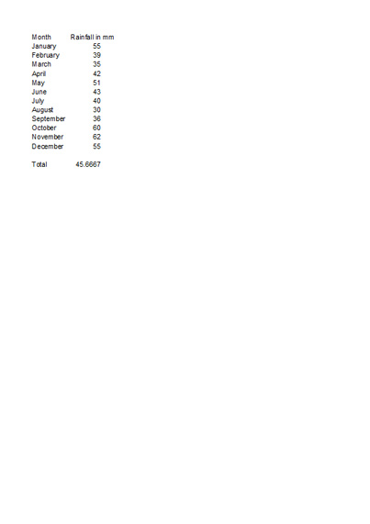
Printing a Spreadsheet
Use Print Preview to see how the printed spreadsheet will look.
Use Print to print the spreadsheet.
Next >

Slide 11
Question 1
Which of these spreadsheet functions is accessed from the menu?
A) Saving a file
B) Printing a file
C) Opening a file
D) All of the above
Next >

Slide 12

Question 1
Which of these spreadsheet functions is accessed from the menu?
A) Saving a file
B) Printing a file
C) Opening a file
D) All of the above
The menu is used for all these functions.
Next >

Slide 13
Question 2
In a spreadsheet, text is entered into small boxes. What is the name of these boxes?
A) Files
B) Lines
C) Cells
D) Preview
Next >

Slide 14
Question 2
In a spreadsheet, text is entered into small boxes. What is the name of these boxes?
A) Files
B) Lines
C) Cells
D) Preview
A spreadsheet consists of a number of small boxes called cells.
Next >

Slide 15
Summary
In this presentation you have seen:
how to open a spreadsheet
how to save a spreadsheet
how to access Help
how to print a spreadsheet
End

